Slide 1
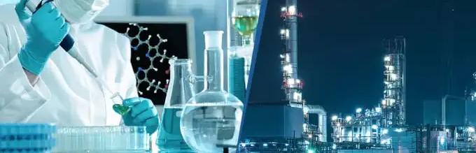
Industrial Chemistry
An introduction

Slide 2

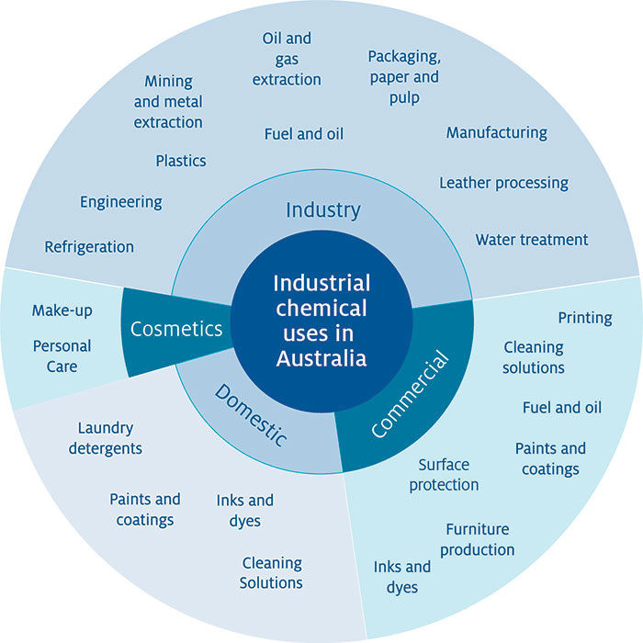
An introduction - overview
Examples of industrial processes
Green chemistry principles
Optimising yield and rate

Slide 3
Examples of industrial processes
Industrial chemistry incorporates the world of manufacturing including the production of pharmaceuticals, chemicals for food production (fertilisers all the way to food additives), polymers and plastics, fuels, cleaning products, chemicals for research… the list is endless
Industrial chemistry uses natural materials (crude oil products, biomass such as wood, resins, minerals and water) to synthesis the products of our modern world

Slide 4
Examples of industrial processes
Some examples that we will focus on are:
Production of ethanol including reviewing biofuels
Haber process for producing ammonia
Contact process for producing sulfuric acid
Ostwald process for producing nitric acid

Slide 5
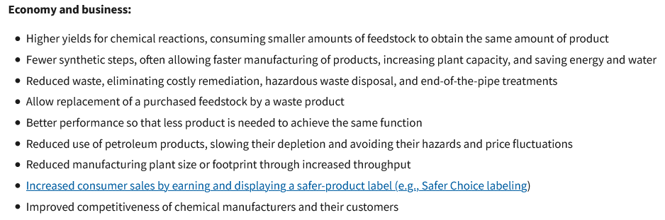
The economic realities
https://www.epa.gov/greenchemistry/benefits-green-chemistry

Slide 6

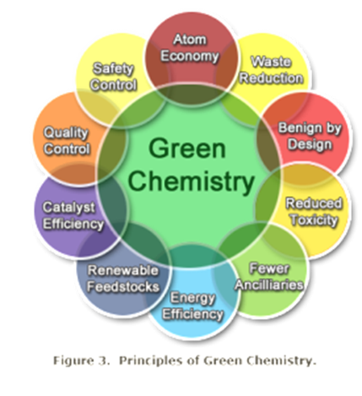
Green chemistry
Green Chemistry is the utilisation of a set of principles that reduces or eliminates the use or generation of hazardous substances in the design, manufacture and application of chemical products .

Slide 7
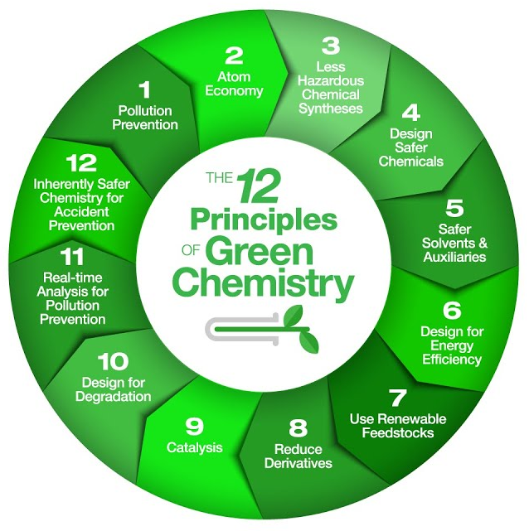
Green chemistry – twelve principles
Prevention
Atom economy
Less hazardous chemical synthesis
Designing safer chemicals
Safer solvents and auxiliaries
Design for energy efficiency
Use of renewable feedstocks
Reduce derivatives
Catalysis
Design for degradation
Real-time analysis for pollution prevention
Inherently safer chemistry for accident prevention

Slide 8
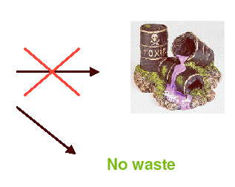
Green chemistry - prevention
Chemical
Process

Slide 9
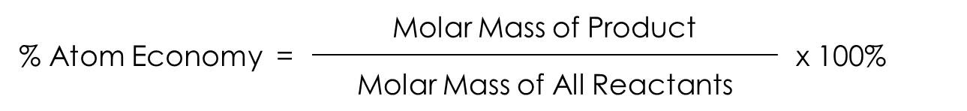
Green chemistry

Slide 10
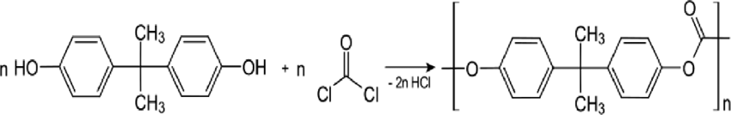
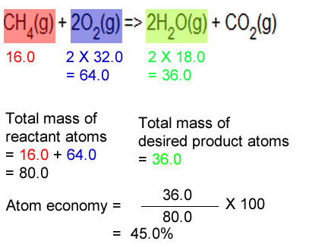
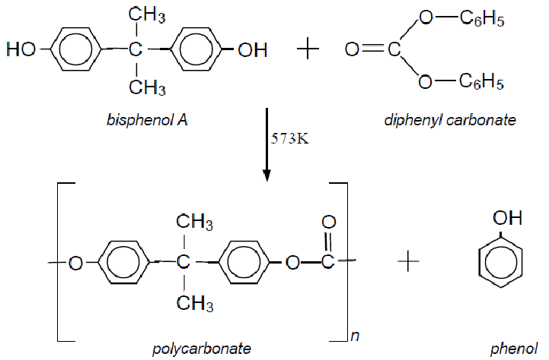
Green chemistry
Synthesis of polycarbonates:
Method 1: uses phosgene a highly toxic reagent
Method 2: uses diphenyl carbonate which is less toxic, therefore less hazardous
Principle 3 – Safer chemicals. You will see a lot of products with BPA free, BPA is Bisphenol A (the diol above!) it has been link to adverse health effects.

Slide 11
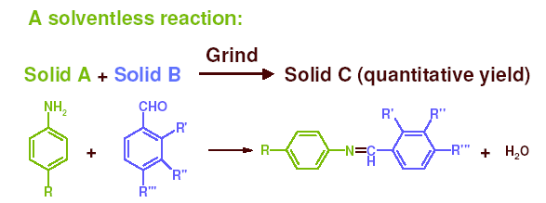
Green chemistry

Slide 12
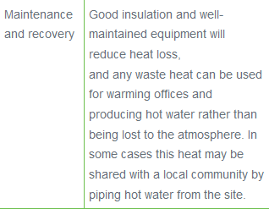
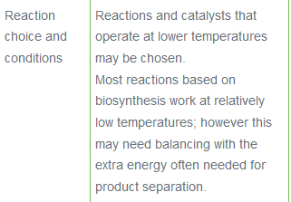
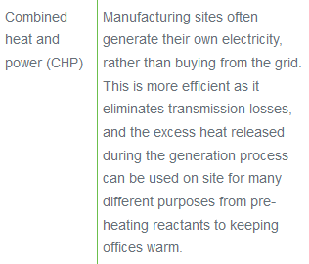
Green chemistry
Energy efficiency in chemical industry

Slide 13
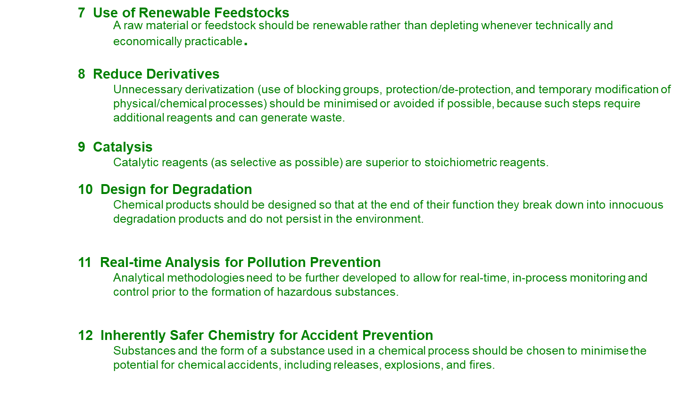
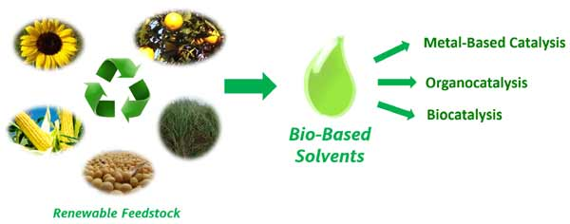
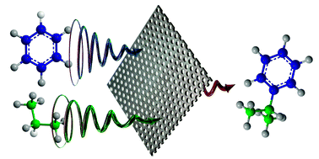
Green chemistry
Zeolite catalysts – are solid phase catalysts, making it easy to recover and reuse

Slide 14
Green chemistry

Slide 15
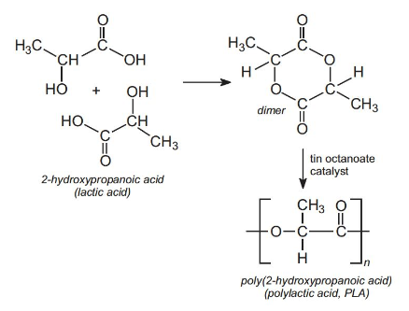
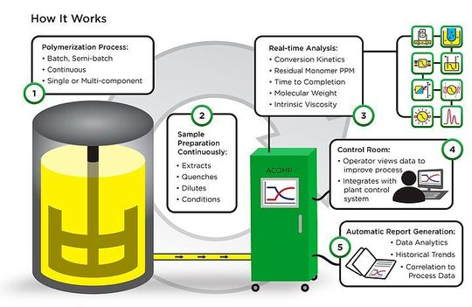
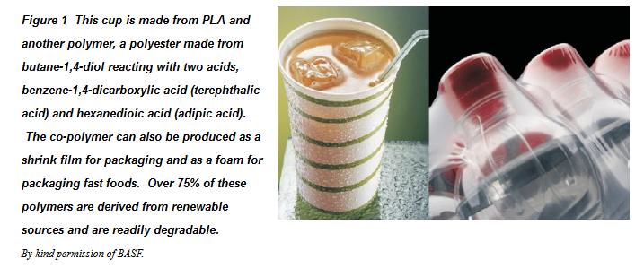
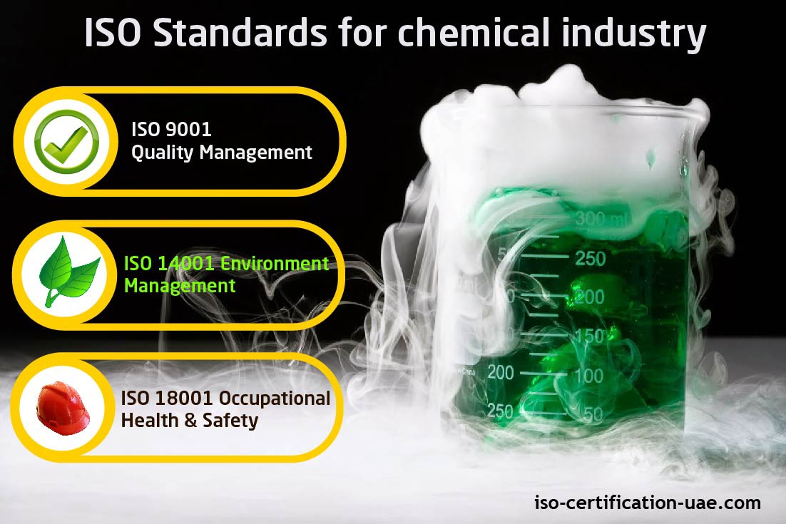
Green chemistry

Slide 16
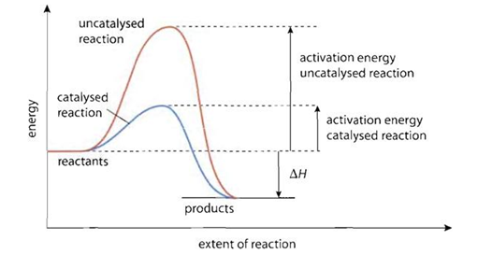
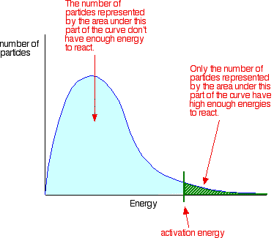
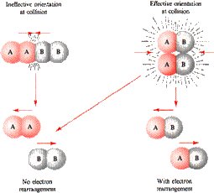
Optimising synthesis processes
While addressing the green chemistry objectives, a chemical synthesis process will need to be optimised for both reaction yield and rate of reaction.
An application of Kinetic Theory and Collision Theory can maximise reaction rates.
An application of Le Chatelier’s Principle can optimise reaction yields.

Slide 17
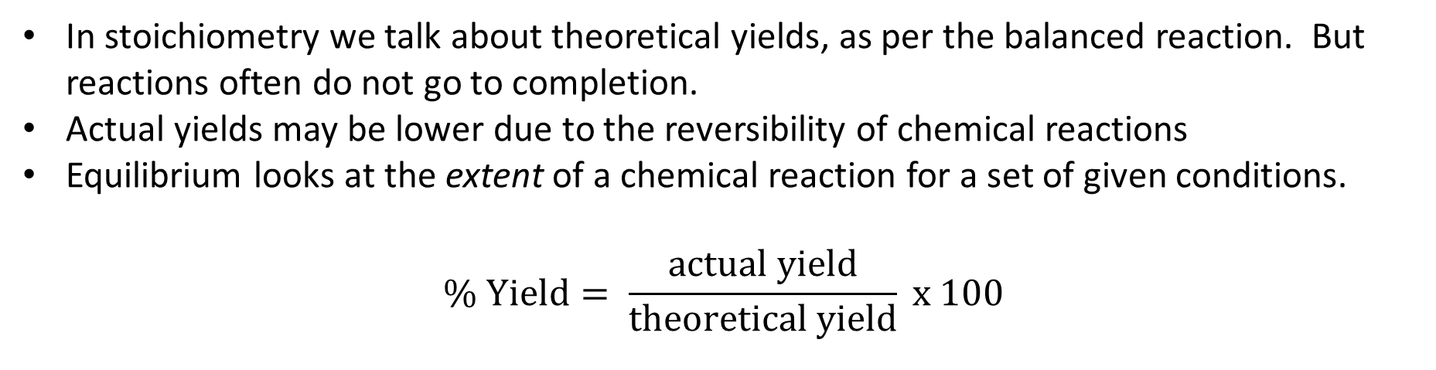
Yields
In stoichiometry we talk about theoretical yields, as per the balanced reaction. But reactions often do not go to completion.
Actual yields may be lower due to the reversibility of chemical reactions
Equilibrium looks at the extent of a chemical reaction for a set of given conditions.
$$\% Yield= \frac{actual yield}{theoretical yield} x 100$$
Where: actual and theoretical are in the same units (moles or mass) and under same conditions.

Slide 18
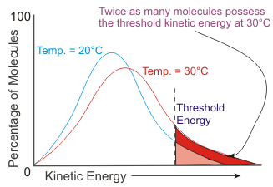
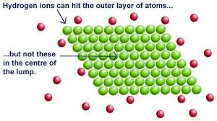
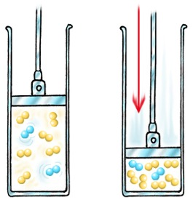
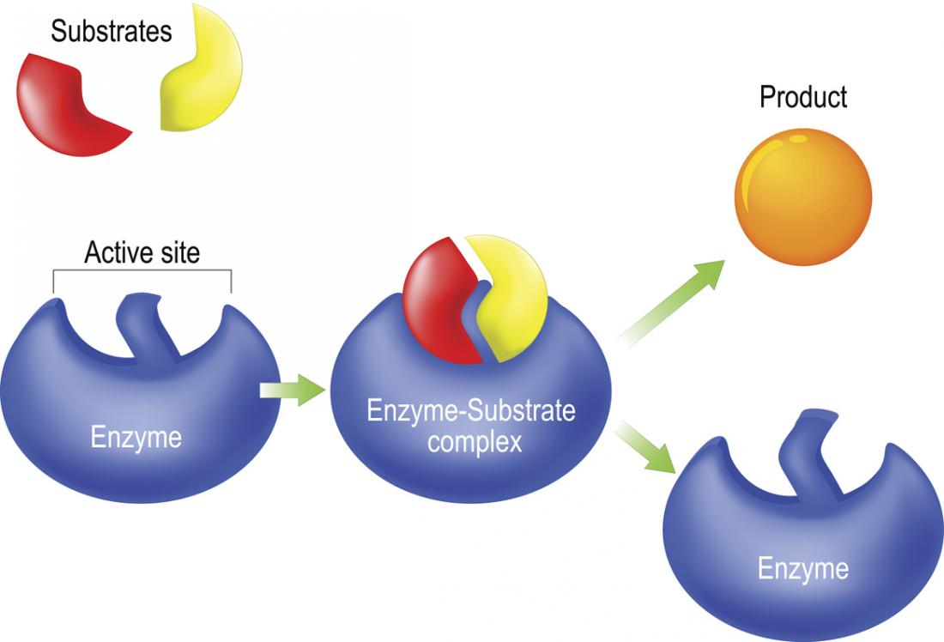
Reaction rates
Kinetic Theory and Collision theory show that reaction rates are influenced by several factors:
Temperature
Surface area/Subdivision
Concentration/Pressure
Nature or reactants/Products
Presence of a catalyst
In industry the use of enzymes as biological catalysts is embraced also. They can operate at lower temperatures and prevent side reactions over traditional catalysts.

Slide 19
Equilibrium factors
An understanding of Le Chatelier’s Principle is also important to consider factors which influence the yield of products formed at equilibrium.
A constant feed of reactants in there stoichiometric proportions with constant removal of products will maintain the rate driving to the product side.
Temperature and Pressure conditions can also be optimised depending on the nature of the reaction.
Endothermic reactions favoured by higher temperatures
Exothermic reactions favoured by lower temperatures
Gaseous reactants vs Gaseous products
Note: catalysts do not affect yield or position of equilibrium just attained faster
It is important to notice that some conditions may work against maximising the reaction rate factors. Eg temperature, often a compromise is required.

Slide 20
On going work
Essential chemistry set 21 Q1,2,3
Complete set 20 if not done so already

